Slide 1
Predicting Trade Flow
Using CEPII Gravity Dataset
https://github.com/danielcoles1989/dc_accelerator

Slide 2
Business Question
Are we able to use various economic, geographic and political variables to try to predict trade flow between pairs of countries?
Why:
Overcome large lags in reporting of official trade flow data.
Identify ‘underperforming’ trade routes to investigate and ease trade friction.
Type of Problem:
Regression
Measurement:
RMSE
Dataset:
CEPII Gravity Dataset

Slide 3
The CEPII Gravity Dataset
Overview
CEPII Gravity dataset contains various economic, geographic and political variables such as:
iso3: ISO3 alphabetic code, unilateral
distw_harmonic: population-weighted average distance between the most populated cities of each country
gdp: GDP, in current thousands US$ (source WDI/Barbieri), unilateral
col45: 1 if countries are or were in colonial relationship post 1945, bilateral
Raw Dataset ranges from 1948 – 2021. Contains countries which no longer exist. Has:
Over 4,600,000 rows and 87 columns.
Target Variable:
tradeflow_baci: Trade flow, 1000 current USD. Source: BACI, bilateral.
Notes:
CEPII gravity dataset is a massive dataset which contains 87 different variables for each county, which has existed between the years of 1948 and 2021. This contained lots of NULLs where countries stop existing or merge with other countries 238,000 in tradeflow_baci column had the most. This is because some columns also used NULLS where there value would be 0. E.g. countries existed but there was no trade, but could also be NULLS from countries which hadn’t released data.
Contained lots of duplicate columns, e.g. tradeflow where they listed tradeflow from different sources like world trade org, or IMF and different distance measures. Where applicable I chose the column with the lease amount of NULLS.
I immediately subsetted to 17 ‘relevant economic variables to drop less helpful columns like if they shared the same local hegemon, and 2010 – 2019 to avoid covid, and make the dataset manageable. This resulted in just over 500,000 rows.

Slide 4
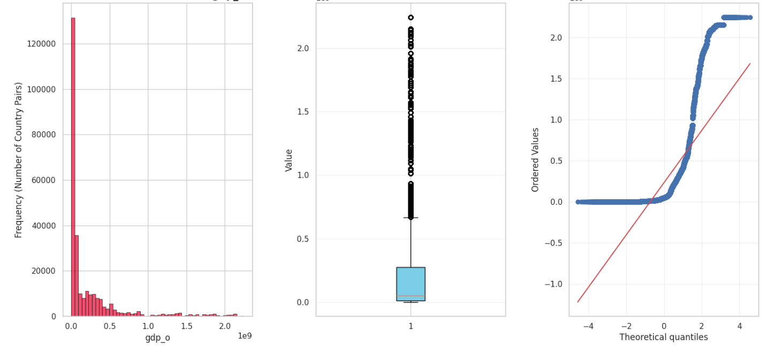
EDA – Independent Variables
Dependent variable not normally distributed and contained lots of outliers.
gpd_o Distribution
Box Plot
Skew: 2.75
Kurtosis: 7.62
Notes:
4 pairs of our dependent variable for the model contained data which wasn’t normally distributed, it was skewed and had various level of high kurtosis. I investigated these outliers and they were all valid data points, and both structural and important to our model, so I didn’t want to drop these. These are plots of GDP of origin countries of trade, but in the repo there are more visuals for other independent variables.

Slide 5
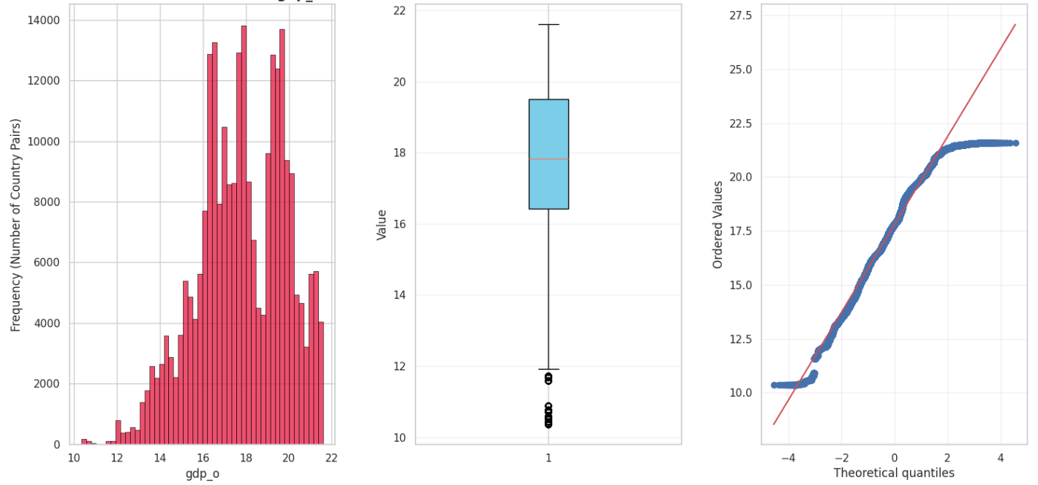
EDA – Independent Variables
Log transformed gdp, population, gpd per capital.
Skew: -0.34
Kurtosis: -0.37
gpd_o Distribution
Box Plot
Notes:
After log transforming the inputs they were much more normally distributed and helped to resolve most outliers. Skew and Kurtosis is within reasonable limits.

Slide 6
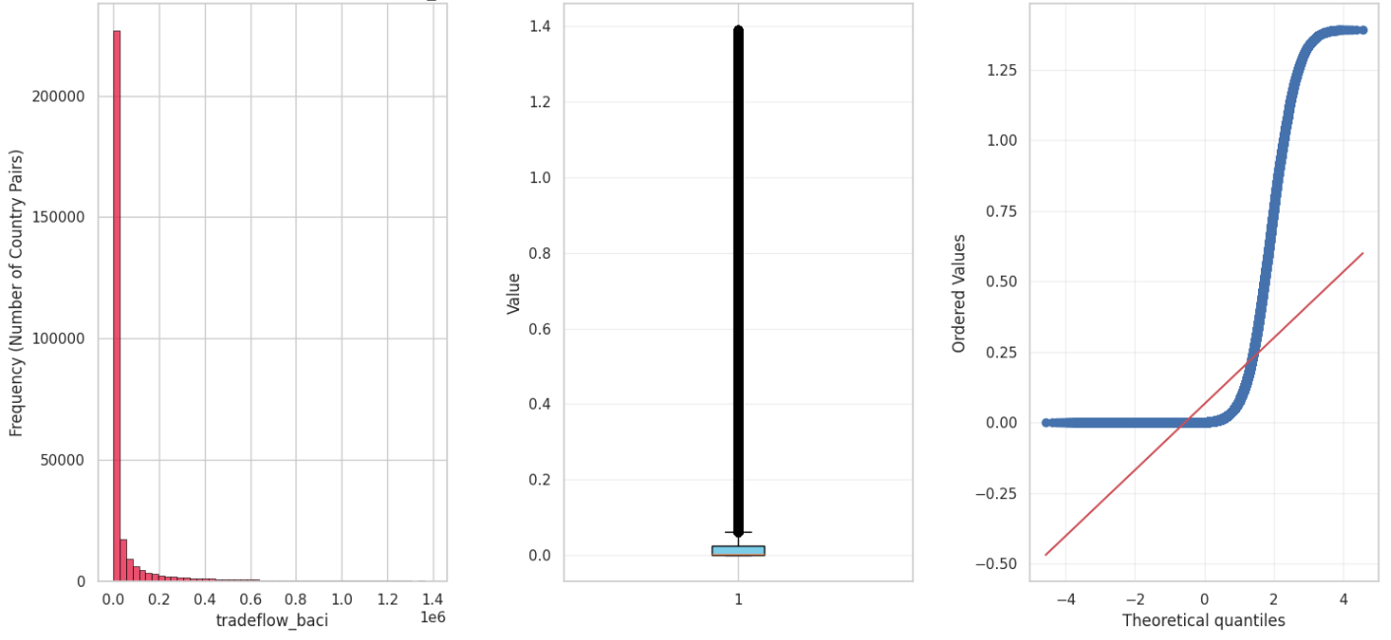
EDA – Dependent Variable
Log transformed tradeflow_baci to explain outliers and skew.
tradeflow_baci Distribution
Box Plot
Skew: 4.15
Kurtosis: 18.89
Notes:
My dependent variable was also highly skewed with many outliers. Again I didn’t want to remove the outliers based on the box plot because it would effect my model both in terns of number of data points, but also remove lots of the larger trading pairs. I also transformed this prior to machine learning.

Slide 7
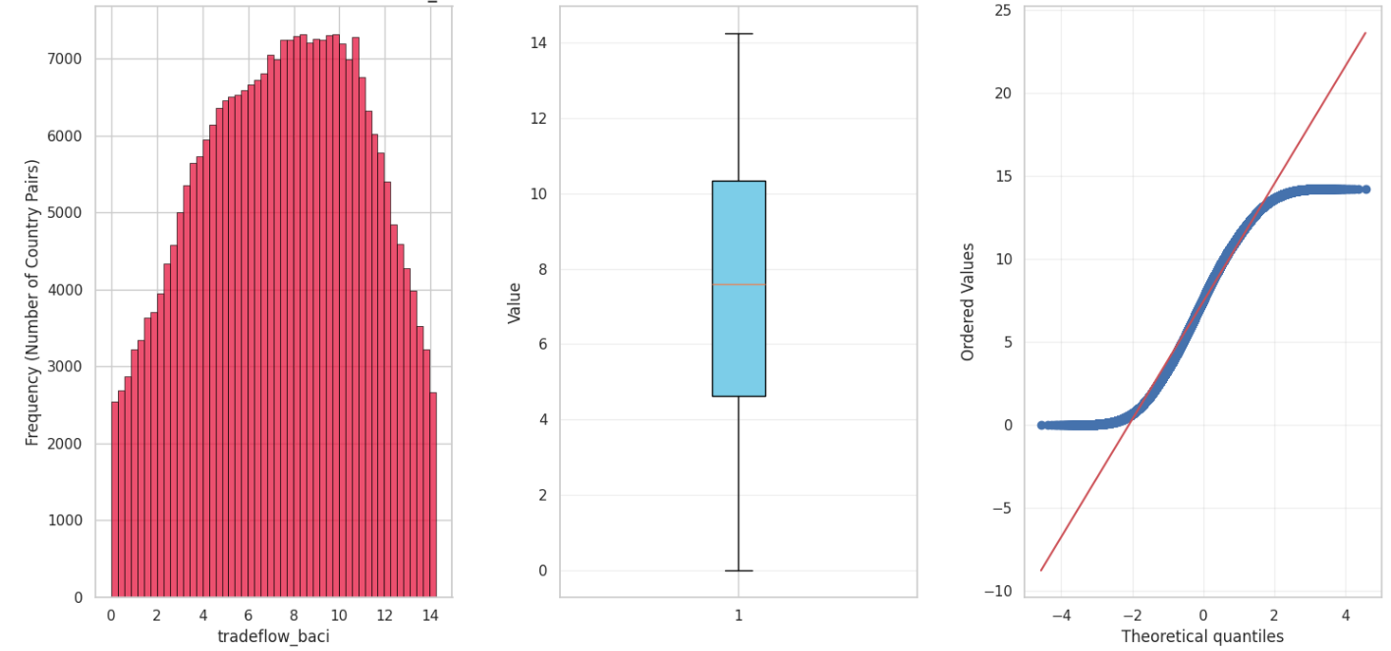
EDA – Dependent Variable
Log transformed gdp, population, gpd per capital tradeflow.
tradeflow_baci
Distribution
Box Plot
Skew: -0.11
Kurtosis: -0.94
Notes:
After log transforming there were no more outliers and data was much more normally distributed.

Slide 8
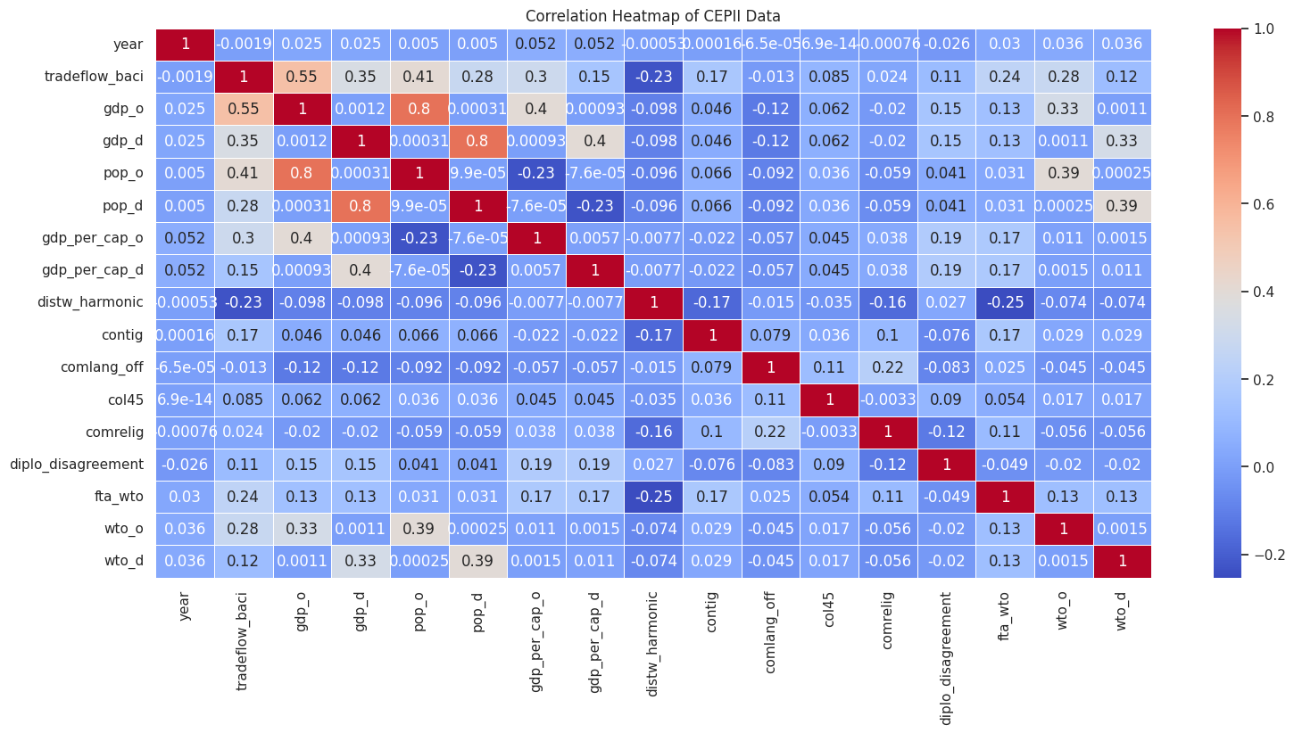
EDA – All Variables
I also investigate correlation between all variables. I noted the correlation between different dependent variables.
Took variables which were over a threshold of +/- 0.2 pearson’s correlation to the target variable.
Notes:
I also plotted a correlation matrix between all variables. I noticed there was multiple input variables which we correlated with each other. I investigated dropping variables such as pop since it is closely related to gdp, but decided against it because they are both different measure, and there are countries with high pop and lower gdp, or vice versa. This can also be explained by another variables gpd per capita. I then took variables over 0.2 into my model.

Slide 9
Null Values
Null values are introduced by 2 ‘main’ methods:
Countries no longer existing or not releasing data.
No trade between countries.
NULLS can be genuine absence of data OR 0 as a result it was hard to try to distinguish between the two. Because of this Nulls where dropped, which impacted smaller nations more than larger ones. Therefore, our model could only accurately predict trade flow of bigger nations, or nations that already have a trading connection.
Column Name | No. of Nulls
tradeflow_baci | 238457
gdp_o | 91650
pop_o | 62275
distw_harmonic | 0
comlang_off | 46000
Notes:
After looking at the metadata, I found that null values can come from either changes to countries, no data being released, or no trade at all i.e., value of 0. We can see that the nulls in the gdp and pop are lower than tradeflow. This is because gpd and pop nulls would be because of countries changing or not releasing data. But tradeflow could also contain the 0 values coded as nulls as well as defunct countries.

Slide 10
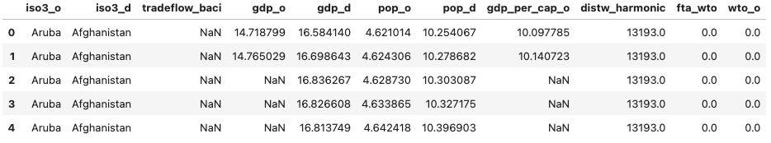
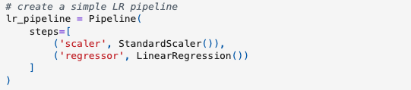
Preprocessing
As previously mentioned all Null rows were dropped. Another reason for this was that some countries had sporadic data points not enough for imputing.
Standard Scaler was used for the Machine Learning Pipelines to transform all variables into a common scale.
Notes:
Because of this nulls were dropped. I investigated backfiling, but because some country pairs has occasional data e.g. 1 or 2 rows, but the time you split into train test, there still wouldn’t be enough to accurately fill in missing values and this couldn’t be done prior to splitting due to leaky data principals.

Slide 11
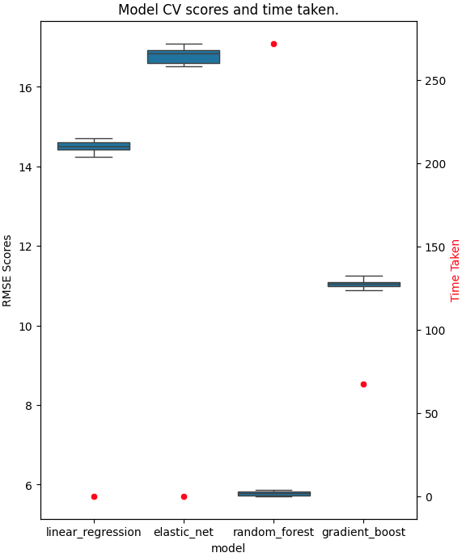
Modelling
I chose 4 baseline models for regression with k-fold of 5. And evaluated with RMSE scores.
These were:
Linear Regression – RMSE: 14.49
ElasticNet – RMSE: 16.80
Random Forest – RMSE: 5.78
Gradient Boost. – RMSE: 11.05
From this plot I hyperparameter tuned Linear Regression and Random Forrest models.
Notes:
I used a baseline model with cv of 5 to get RMSEs for the 4 chosen models to decide which models to tune. I chose Linear regression and random forrest because one is very fast and reasonably accurate, and another has the best RMSE scores, albeit look a long time to fit.

Slide 12
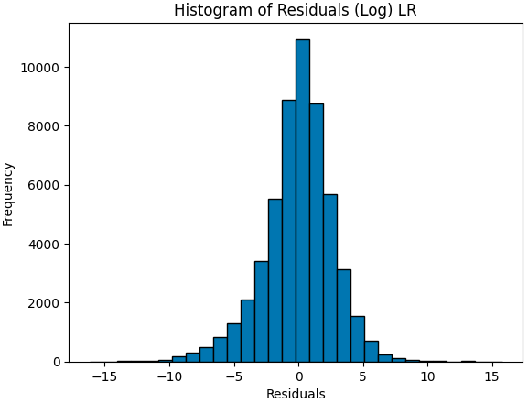
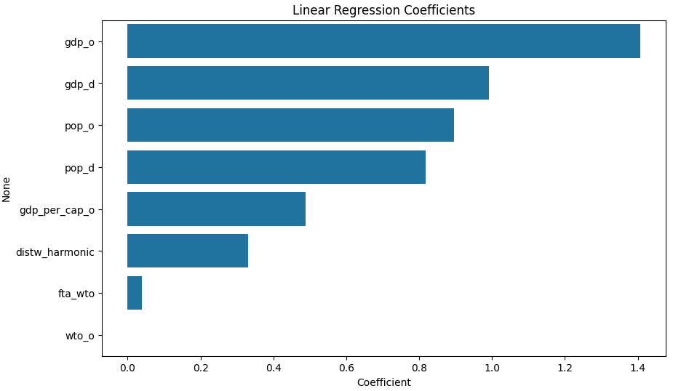
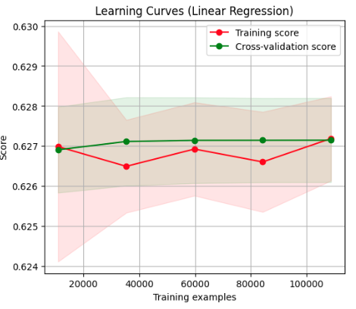
Linear Regression
Hyperparameter tuning didn’t increase accuracy. This may because of a small option of search params resulting in the default arguments being optimal.
Notes:
Hyper parameter tuning the linear regression model didn’t increase accuracy. Whether that was because the default parameters where the best, or I should have used a larger set of parameter options. But we can see that it fit fairly accuracy, had expected residuals and didn’t seem to over or underfit the data as show in the learning curve plot and only needed a small amount of data to fit an accurate model. It also resulted in gdp and population as the highest coefficients, also interestingly more of the origin country than the destination. This could suggest ‘seller’ countries are more likely to initiate trades.

Slide 13
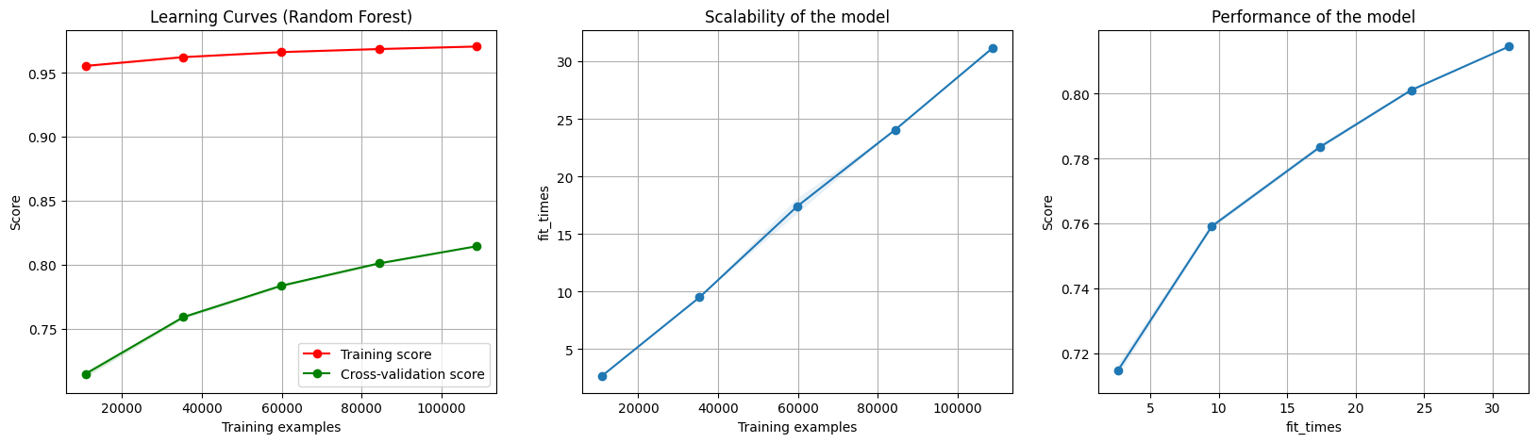
Random Forest
A limited grid resulted in no accuracy gains from tuning this model.
The learning curve plot also show us that this model requires a lot of data. Adding more years or imputing NULL values would help this model’s accuracy to a degree. Overall still very accurate.
Notes:
Again after tuning there was no gains to this model. This could be because of the small similar grid fed into the search. Since it took a long time to run I didn’t experiment with a large set of params. The plot also shows us that this model is still able to get higher accuracy by feeding in more data to help prevent overfitting. But it is starting to level off to a degree. But still was still a very accurate model with RMSE of 5.4 with test data when the raw data can range in the thousands.

Slide 14
Improvements
Use more data:
More years of data
Impute NULLs using KNN
Experiment with more Models:
Ridge/Lasso
XGBoost
Increase GridSearch parameters
Look into rephrasing the question as looking into Causal Inference*
Notes:
Improvements can come from a few different changes, I could use more data, either raw or impute the nulls. I can also use more models like XGBoost and Ridge, since ElesticNet raised an error for heavily penalized coefficients and recommended ridge. I could also use much more options in the grid search. Although the drawback for this would be exponential train times for the random forest model.

